Slide 1

ECE 530 Cloud Computing
Ioannis Papapanagiotou
NoSQL flavors

Slide 2
A NoSQL (originally referring to "non SQL" or "non relational") database provides a mechanism for storage and retrieval of data that is modeled in means other than the tabular relations used in relational databases

Slide 3
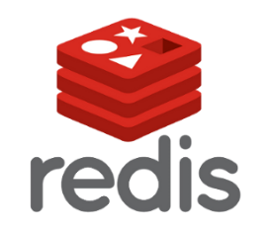




NoSQL Flavors: Key- Value Stores
Azure Table Storage

Slide 4
NoSQL Flavors: Key- Value Stores
Stores Data in buckets as a Key and a Value
Each Key must be unique
Values don’t have a type, can contain any value at all.
“Car” : “Chevy”
“Boat”: “Catamaran”

Slide 5
NoSQL Flavors: Key- Value Stores
Very fast write performance
Very fast read IF you select based on the key
Very slow if you need to search the values
Works great for:
Flat data
Schemas you can’t model with RDBMS
Consider ini files, Dictionary collections, Hashtable collections

Slide 6




NoSQL Flavors: Column Stores

Slide 7
NoSQL Flavors – Column Store
Data is stored as “columns”
Columns consist of a key-value pair and (often) a timestamp
Columns are grouped in “rows” or column families
Columns are grouped generally in tables
No Joins are permitted

Slide 8
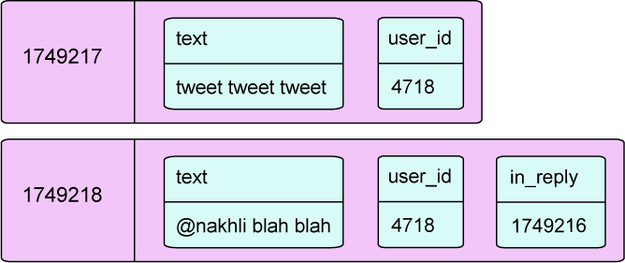
NoSQL Flavors – Wide Columnar Store
No strict schema
Blazing fast processing abilities
Benefits seen through decentralization and scalability
No joins between tables

Slide 9

NoSQL Flavors – Graph

Slide 10
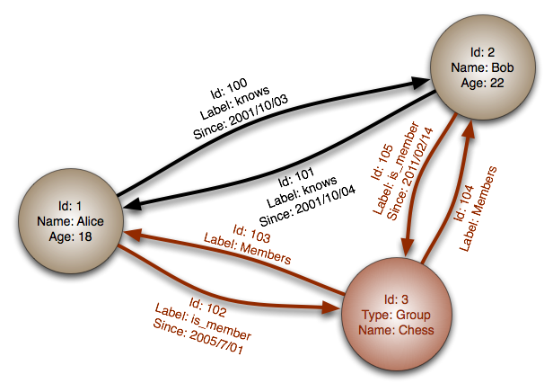
NoSQL Flavors – Graph
NoSQL Flavors – Graph
Think Mathematics graphs, edges and vertices.
Composed of Nodes and Relationships
Both can have key-value collections
Labels (tags) can be added

Slide 11
NoSQL Flavors – Graph
Ideal for when the data you have is defined by relationships
Friend tracking on Facebook
Movie database
Searching for things like:
Friend of a friend of a friend who’s not friends with me
People who worked on a movie with me who haven’t worked with my friend
Find the shortest path between me and this person.

Slide 12


NoSQL Flavors – Document
Azure DocumentDB

Slide 13
NoSQL Flavors – Document Store
Information stored as “Documents”
JavaScript Object Notation (JSON)
Binary forms of JSON
XML
Documents are collections of Key-Value pairs
Documents are collected in “collections”
Values can be strings, dates, Boolean, integers, even documents and arrays

Slide 14
NoSQL Flavors – Document Store
Fast writing
Flexible indexing for fast value searching
Horizontal scaling
Schema-less
Great as an Object Store

